Slide 1

Bon Appetit Recipes
Discover wonderful recipes from all over the world

Slide 2
Bon Appetit App Team
Menna Khaled
Nourhan Ismail
Nada Hesham

Slide 3
What is Bon Appetit Recipes App?
Bon Appétit is the ultimate food app for anyone who loves to cook and explore new cuisines. With Bon Appétit, you can discover the most popular dishes from around the world, learn how to cook them, and get inspired to create your own culinary masterpieces.
The app features a comprehensive database of recipes, organized by country. Each recipe includes a detailed description, step-by-step instructions.
To get started, simply choose a country from the list and explore the popular dishes that are native to that region.
Once you've found a recipe that you're interested in, simply tap on it to view the full instructions. The instructions are clear and easy to follow, even for beginner cooks.

Slide 4
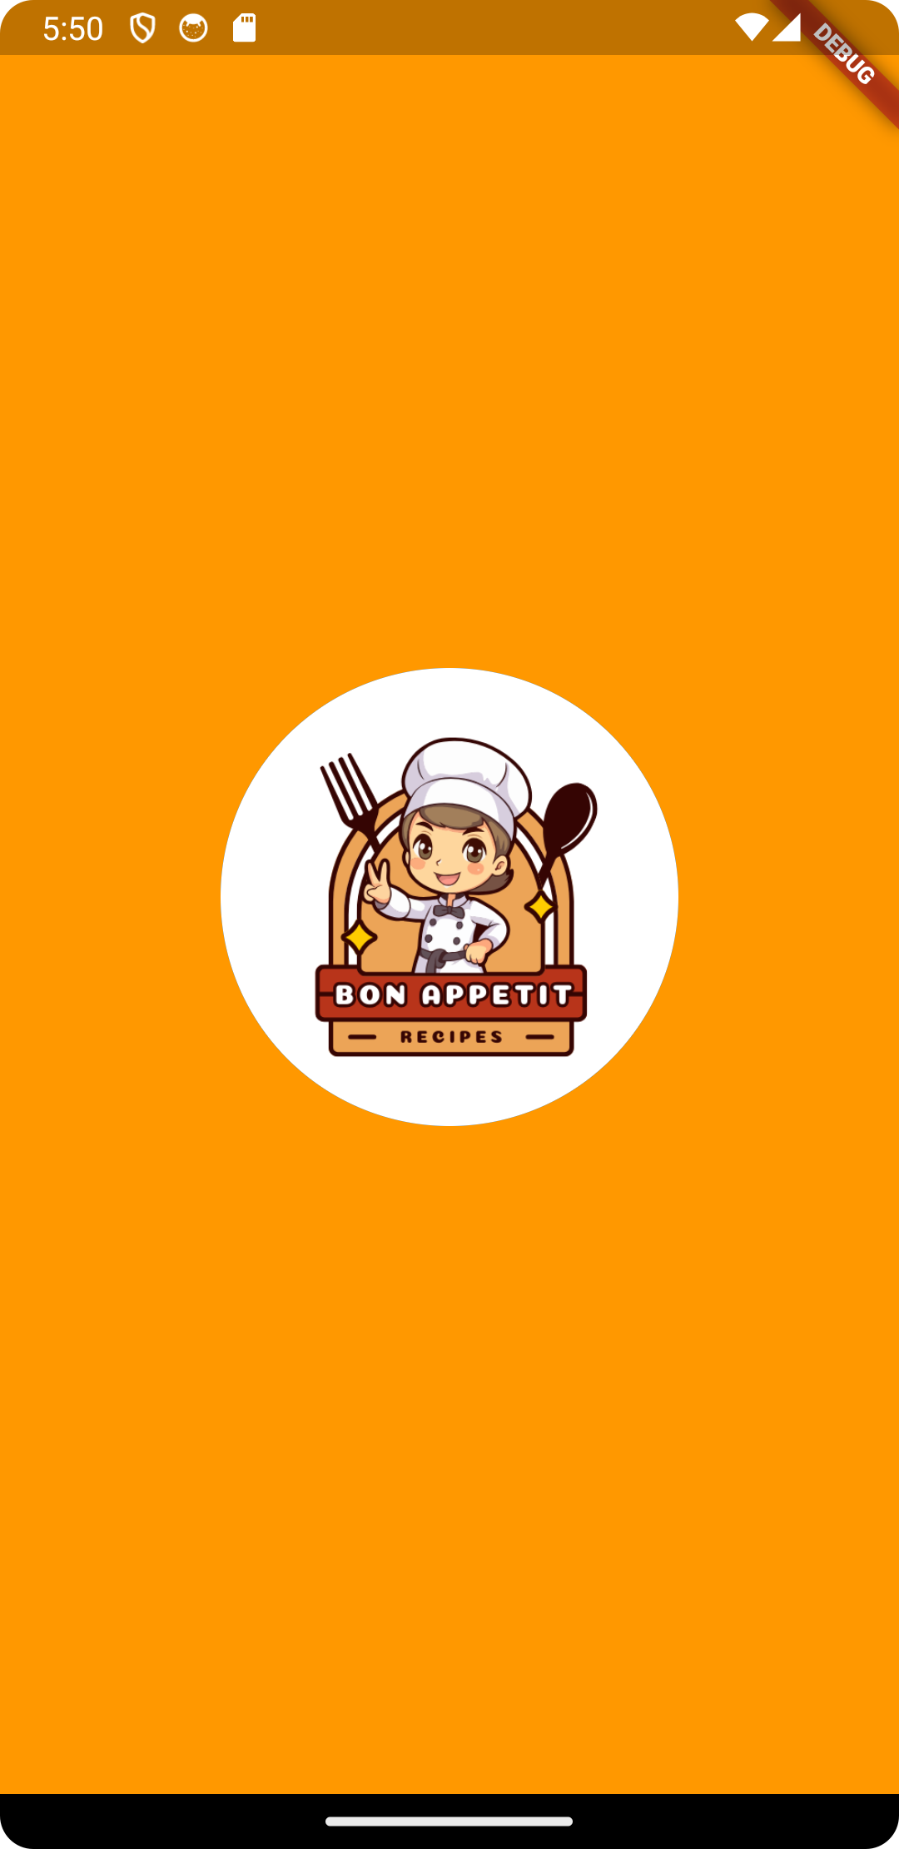
Welcome Screens
Splash Screen

Slide 5
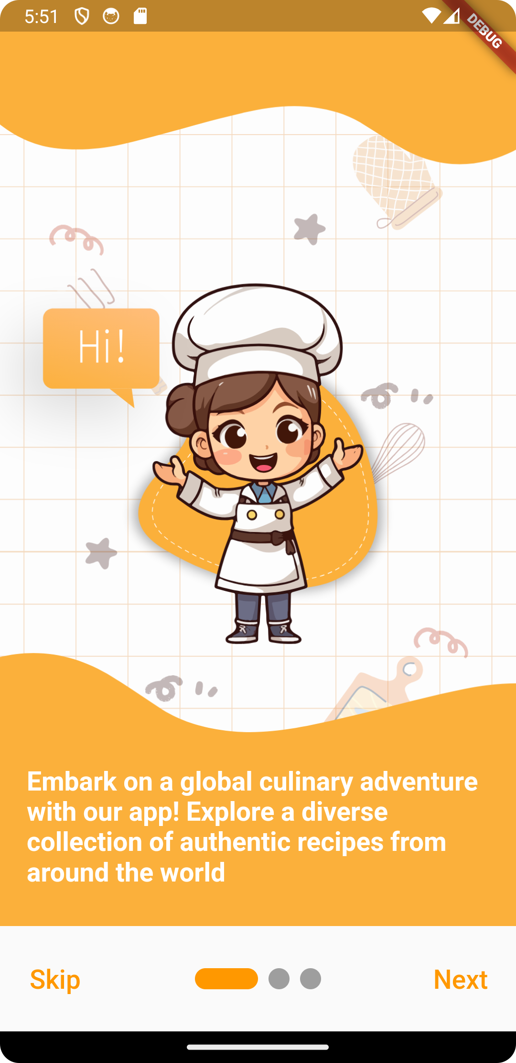
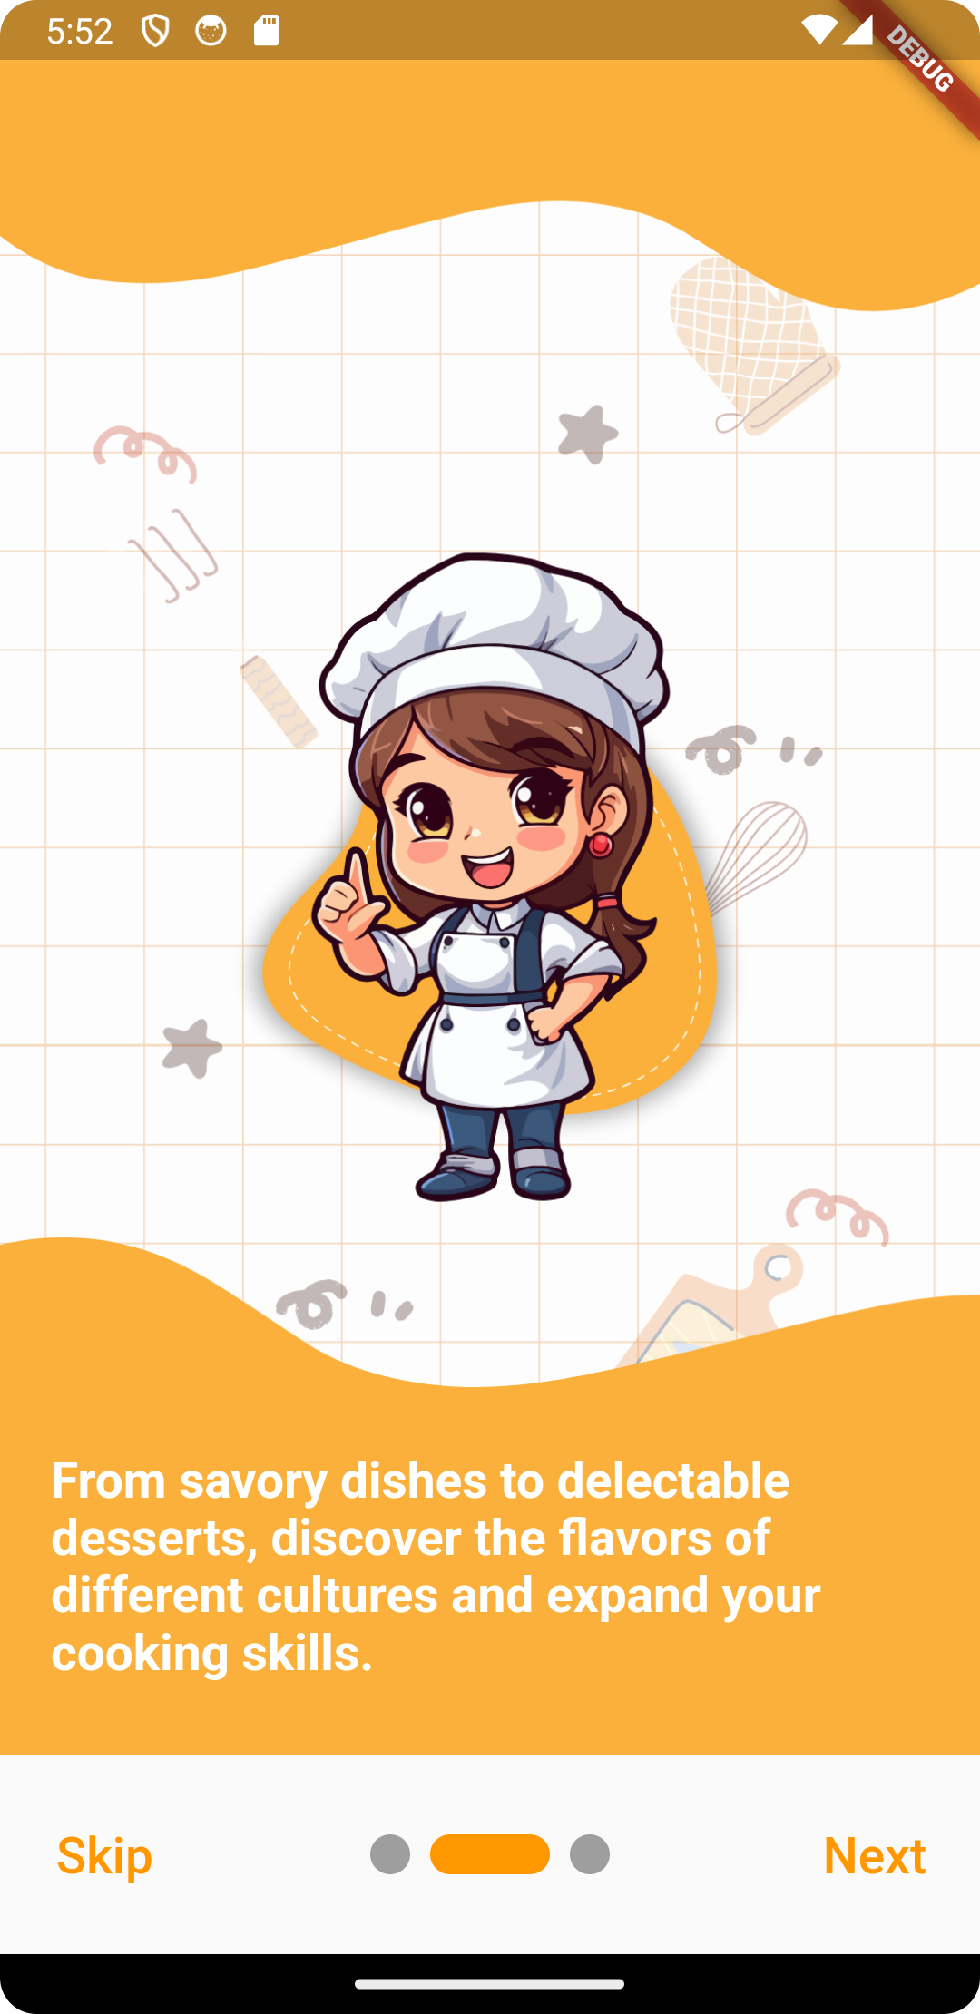
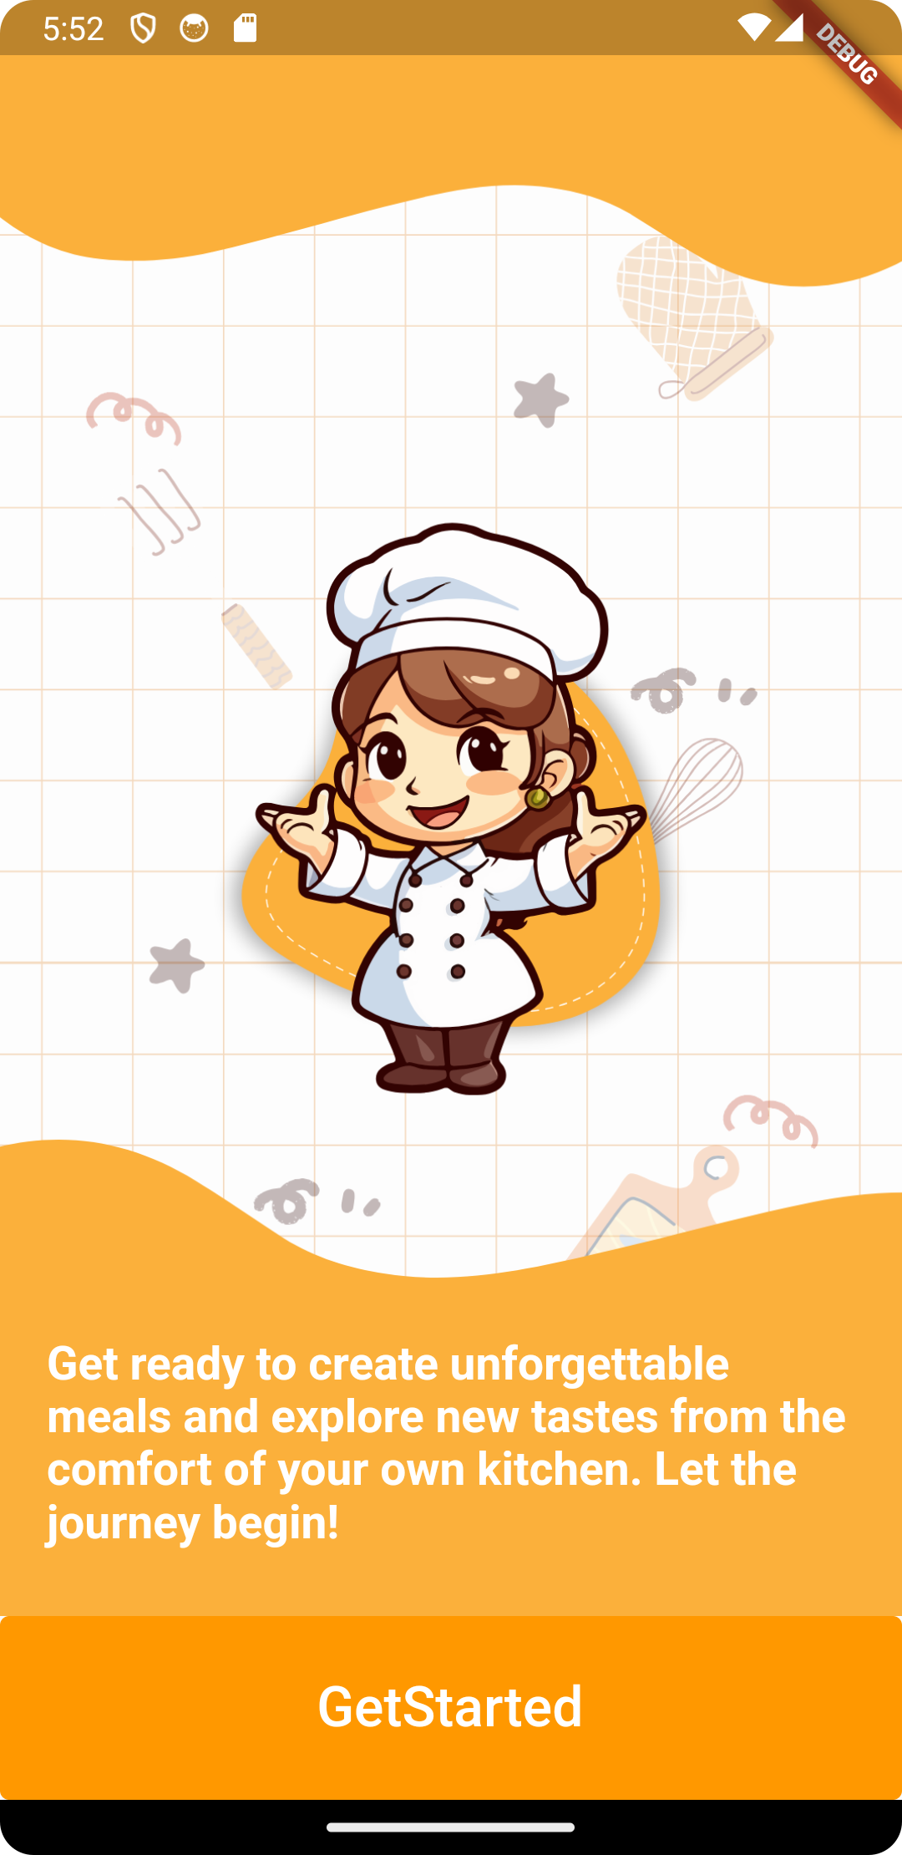
Welcome Screens
On boarding
Screens

Slide 6
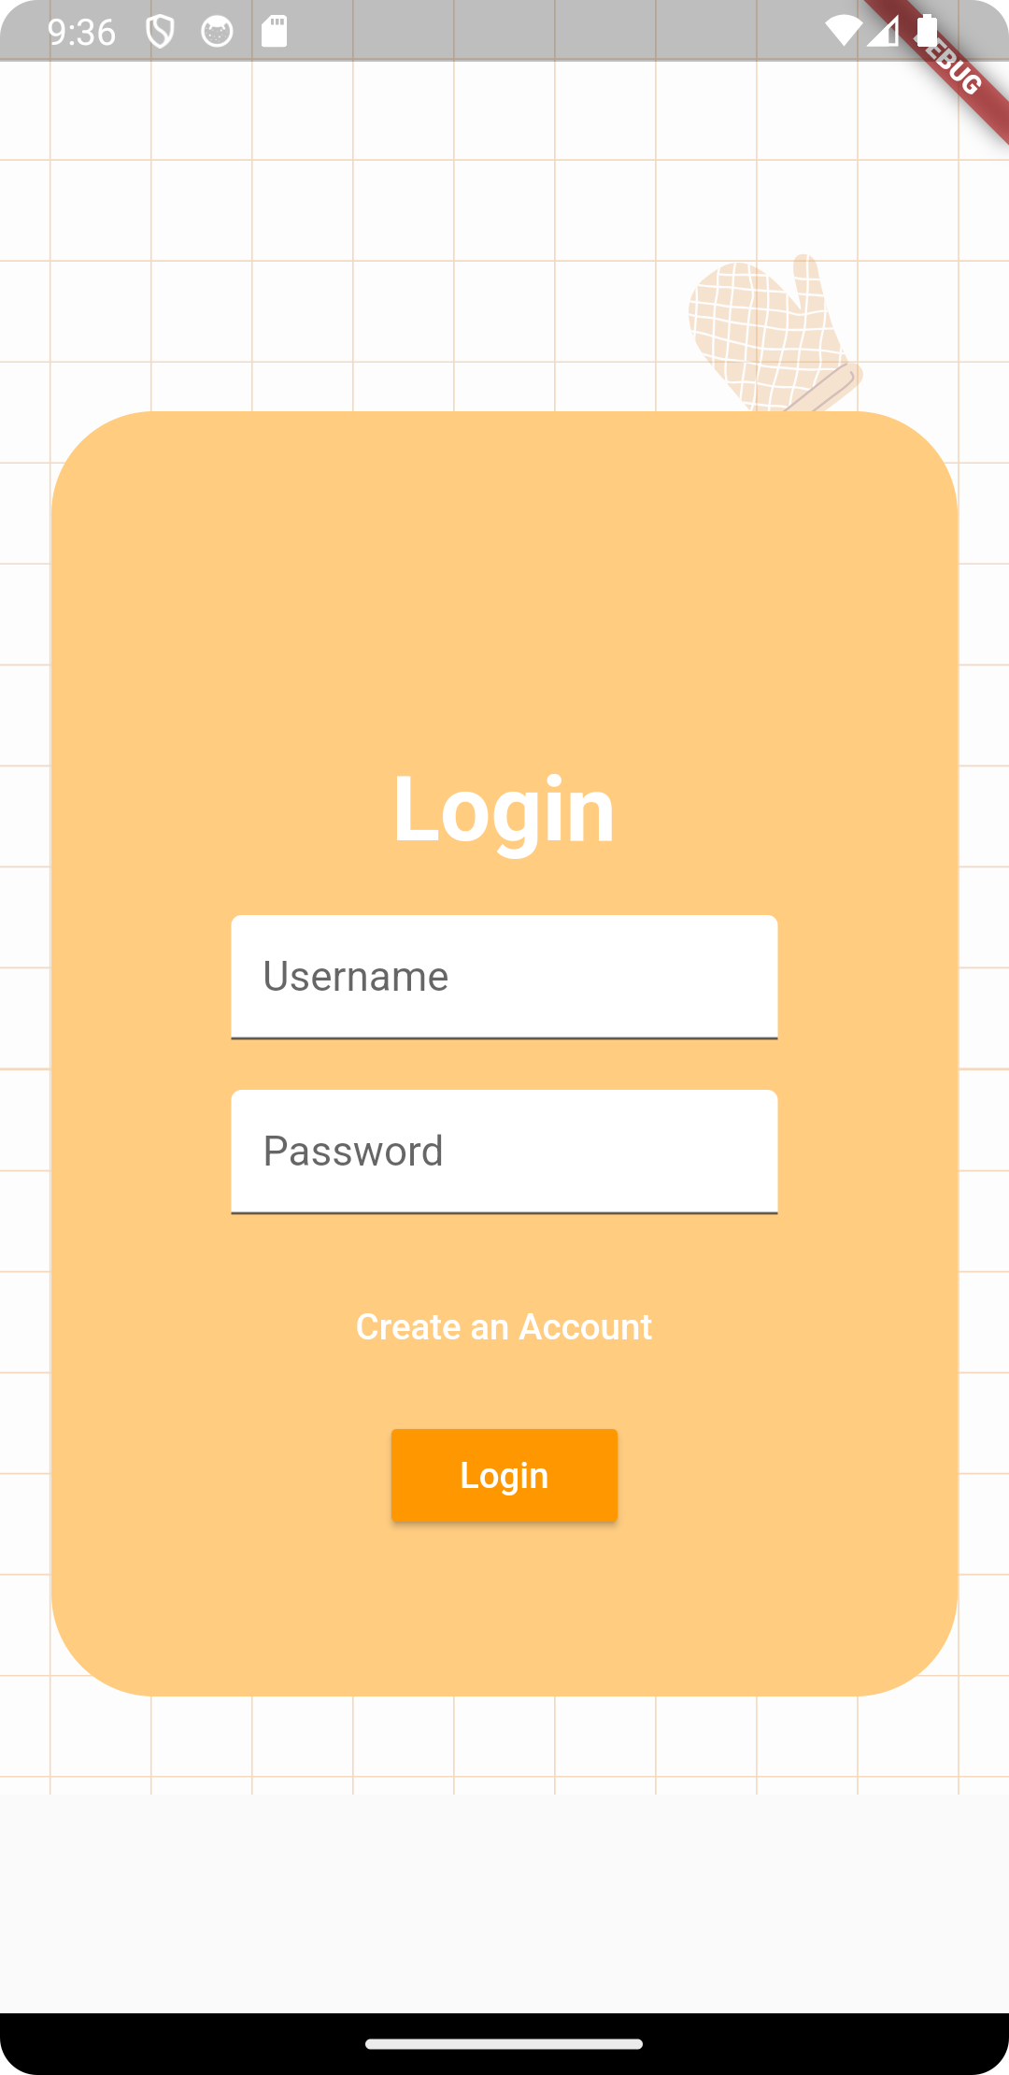
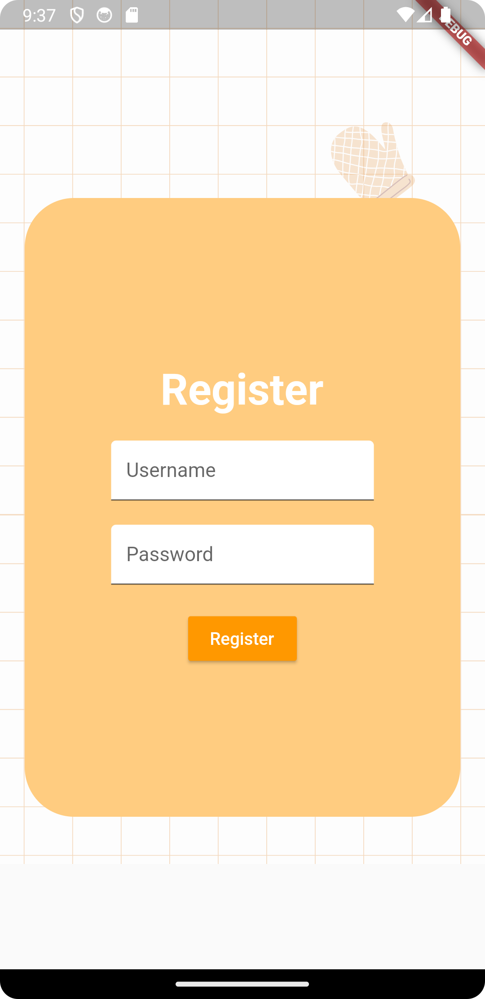
Login and Register

Slide 7
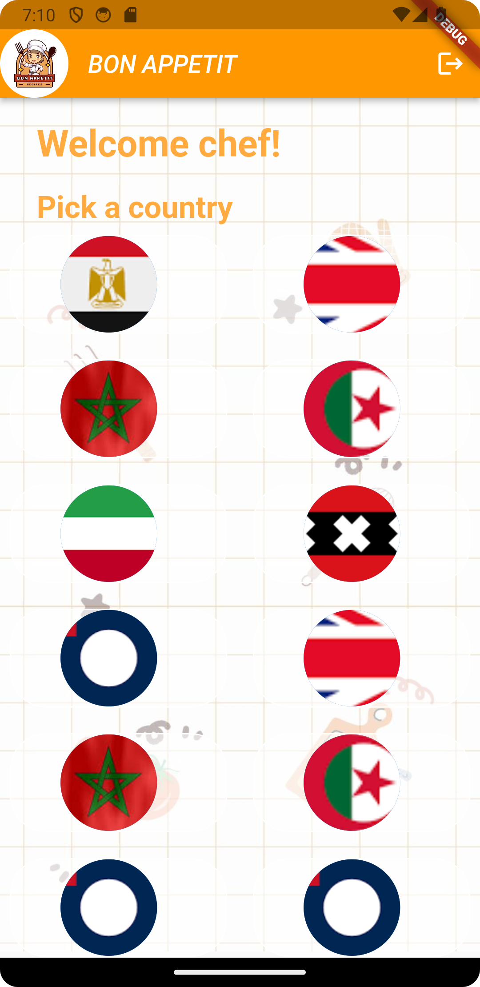
Main Screens
Home Screen
Users can pick the country they want.

Slide 8
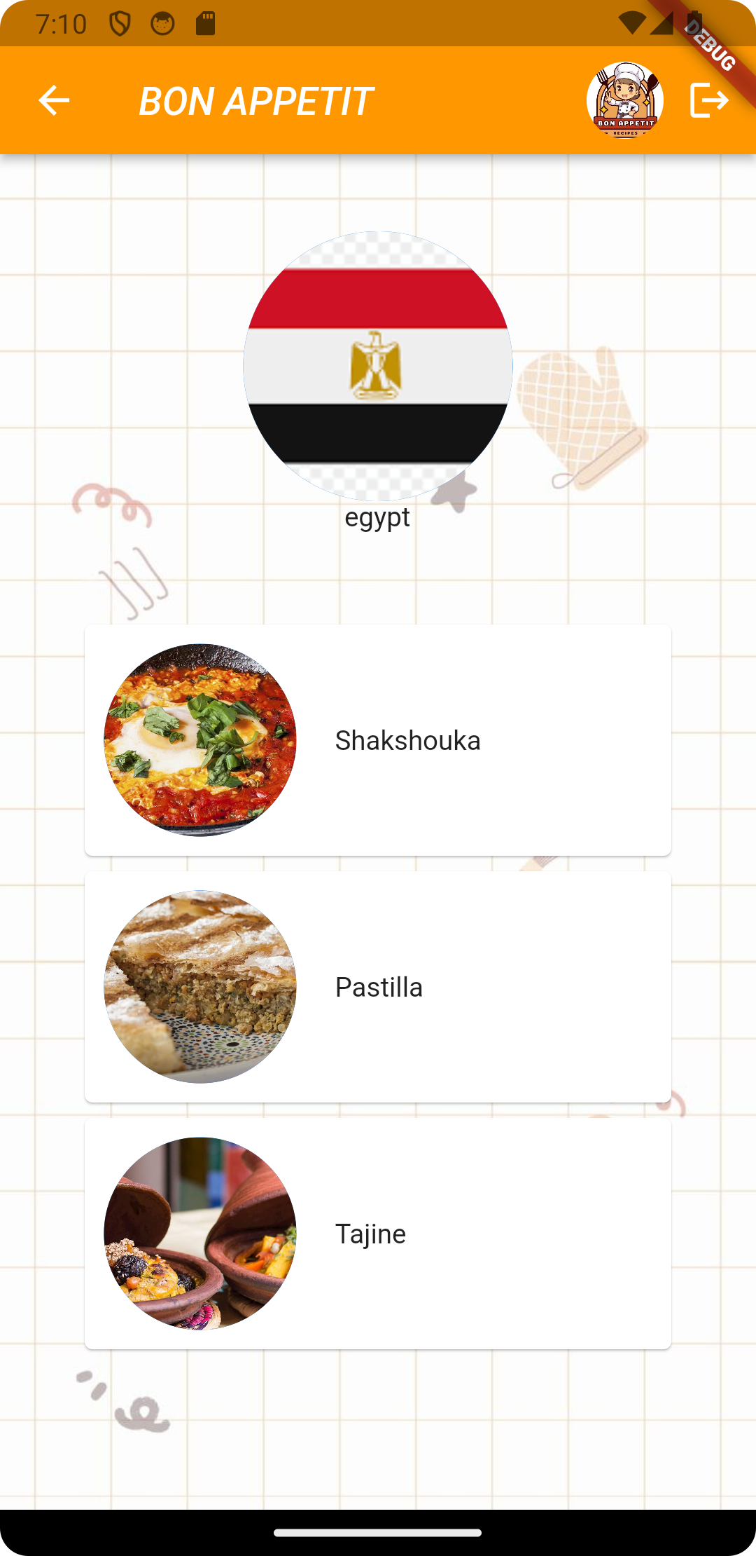
Main Screens
Country Screen
Users can pick the meal they want.

Slide 9
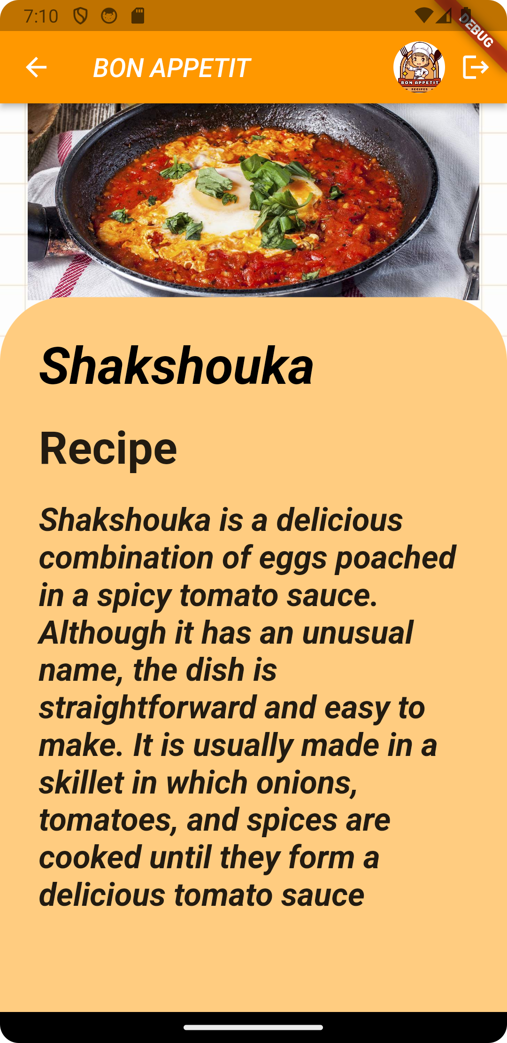
Main Screens
Meal Screen
Users can get the info they need about the meal.

Slide 10

Demo Video

